Slide 1
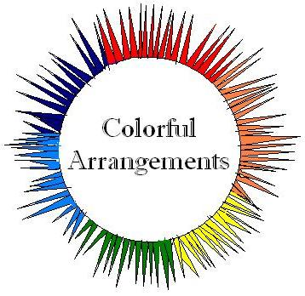
Colorful Arrangements
By Kristyn Gee & Kalvin Lam

Slide 2
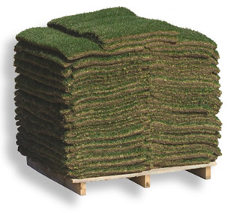
Rainbow Grass
Colorful grass that easily brings beauty to your home
Easy to install and maintain
Manufactured in Northern California

Slide 3
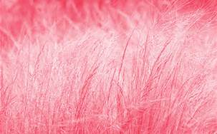
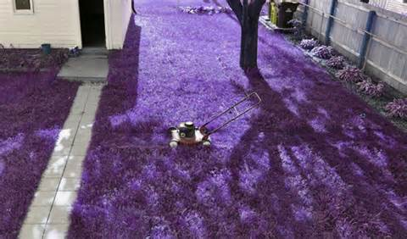
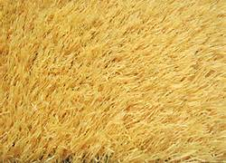
Product

Slide 4
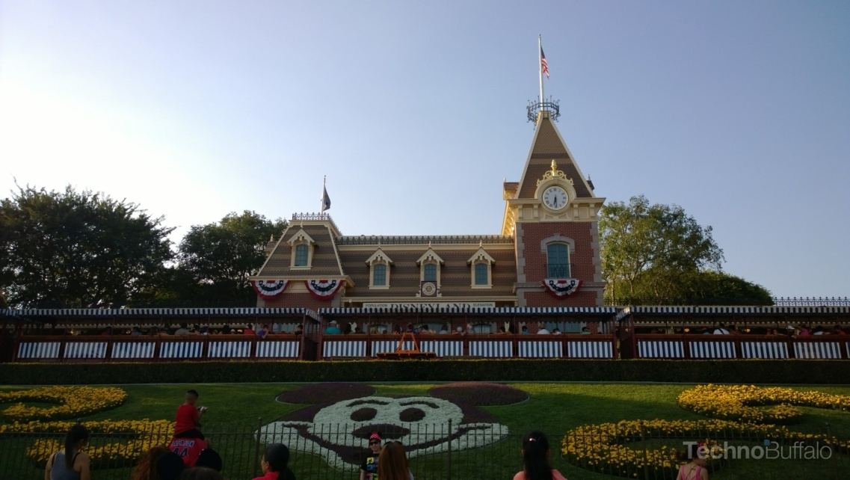
Market and Competition
Target Market:
Home owners, amusement parks, parks, gardens.
Competition:
Landscapers and florists

Slide 5
Price
It would cost about $1 per square foot.
The fertilizer to grow the grass, the climate to grow the grass, the employees that grow the grass.
Adaptation
Would not need any modification to be sold internationally.

Slide 6
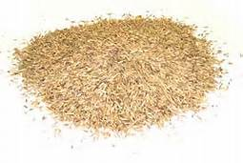
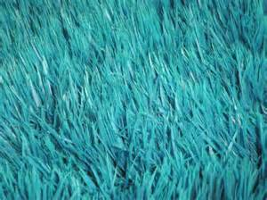
Sourcing
We will be make-sourcing our product
Have our own seeds.
Hire and train employees to grow the grass

